Slide 1
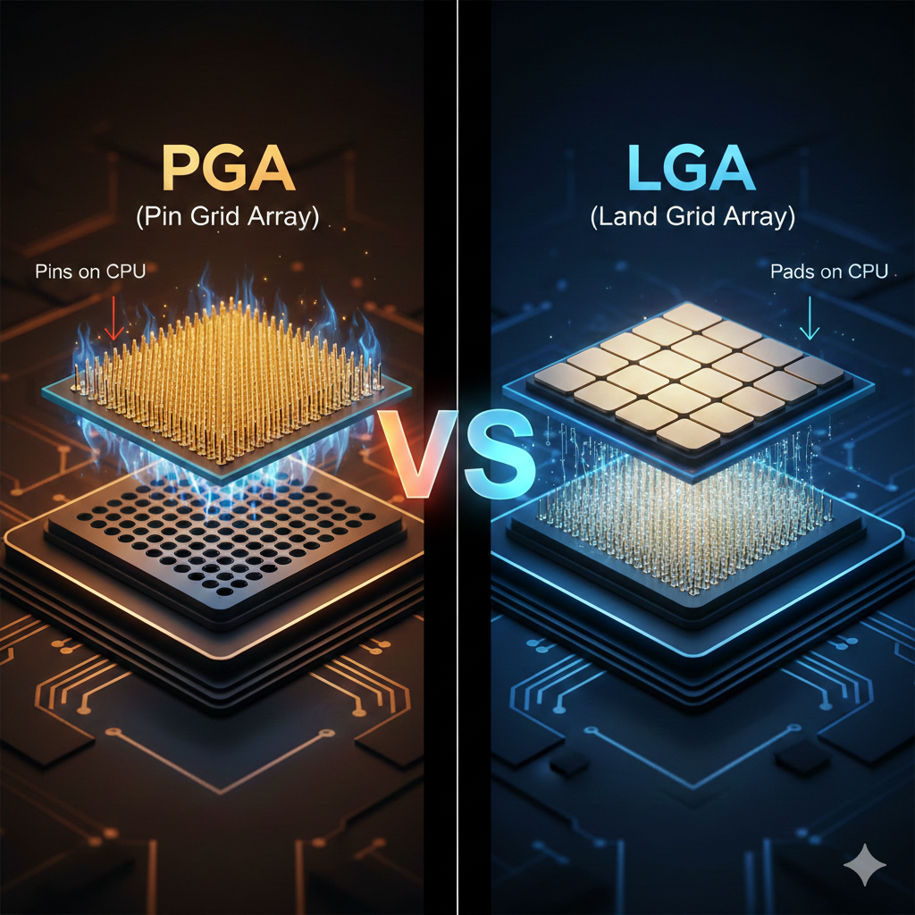
Understand CPU Sockets Presented by : Ihtesham ud din 25-CS-116 Section A

Slide 2
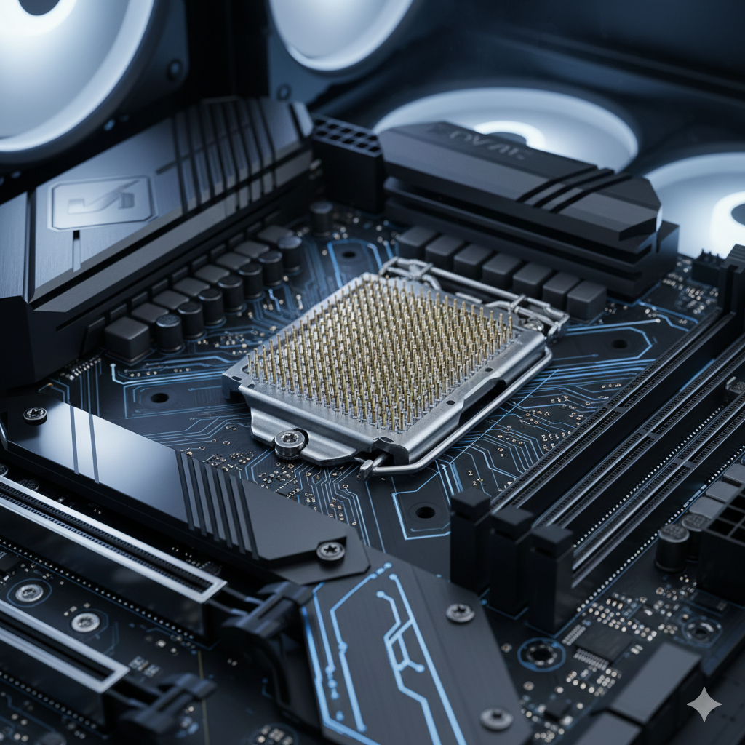
Overview of CPU Sockets
A CPU socket is the physical and electrical interface on a motherboard that connects the processor (CPU) to the rest of the system. It allows the CPU to be installed without soldering, making upgrades and repairs possible.
PGA (Pin Grid Array): The pins are located on the underside of the processor.
LGA (Land Grid Array): The pins are located inside the motherboard socket, while the CPU has flat gold pads (lands).

Slide 3
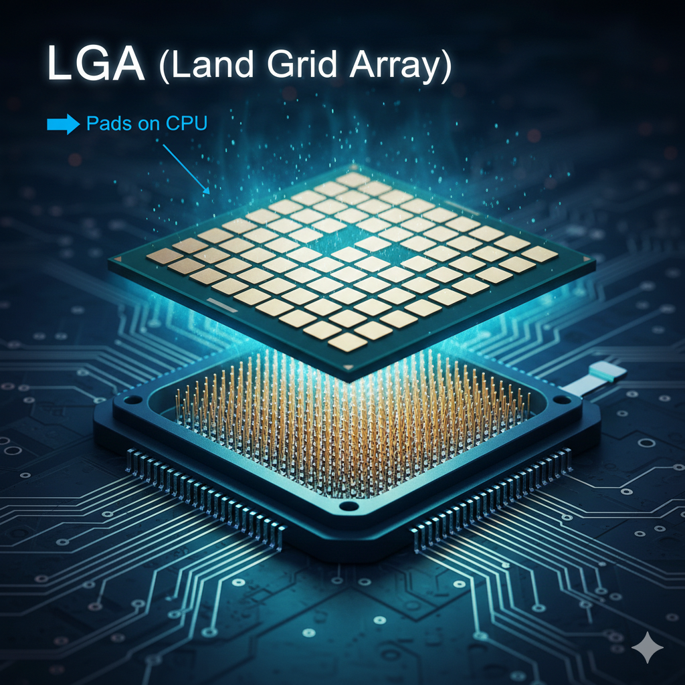
What is LGA (Land Grid Array)? LGA is a type of CPU socket and packaging technology where the connection pins are located on the motherboard rather than on the processor. ADVANTAGES LGA is the best choice for fast, modern computers because it is more powerful and protects your expensive CPU from being damaged. Disadvantages The main problem with LGA is that the motherboard socket is very easy to break and almost impossible to fix if you make a mistake.

Slide 4
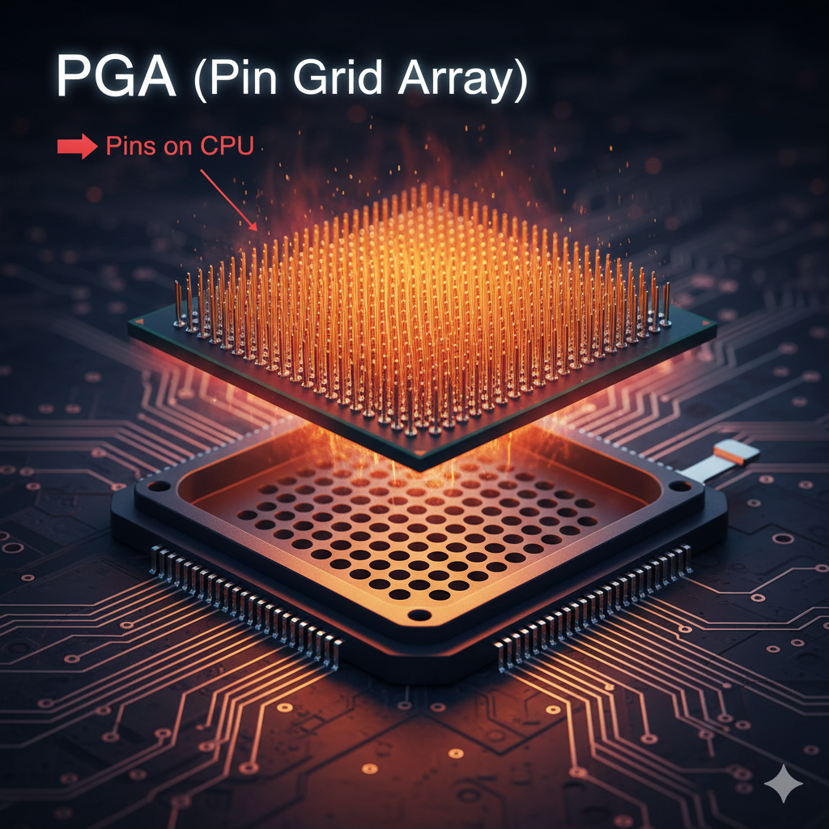
What is PGA (Pin Grid Array)? is a type of CPU packaging and socket design where the electrical connection pins are located on the underside of the processor. The tasks of the PGA processor design are to connect the CPU to an accessible location to replace or remove without hurting the motherboard. Advantages PGA is faster and easier to install because the pins on the CPU simplify alignment and reduce the risk of manufacturing errors. Disadvantages The biggest problem with PGA is that the fragile pins are on the expensive CPU, so if you drop it or bend a pin, the entire processor can be easily ruined.
PGA

Slide 5
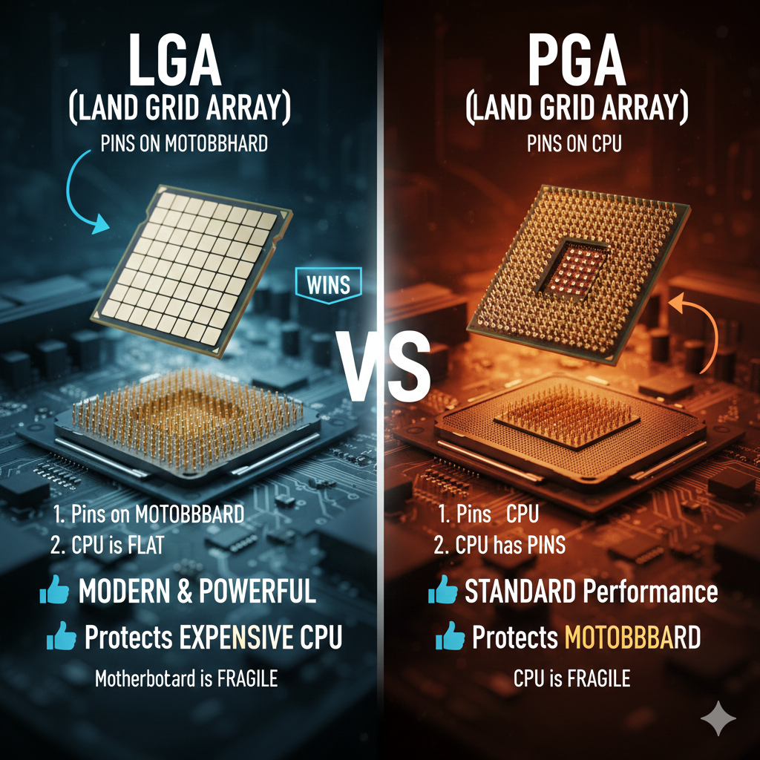
LGA vs. PGA – Which is Better?

Slide 6
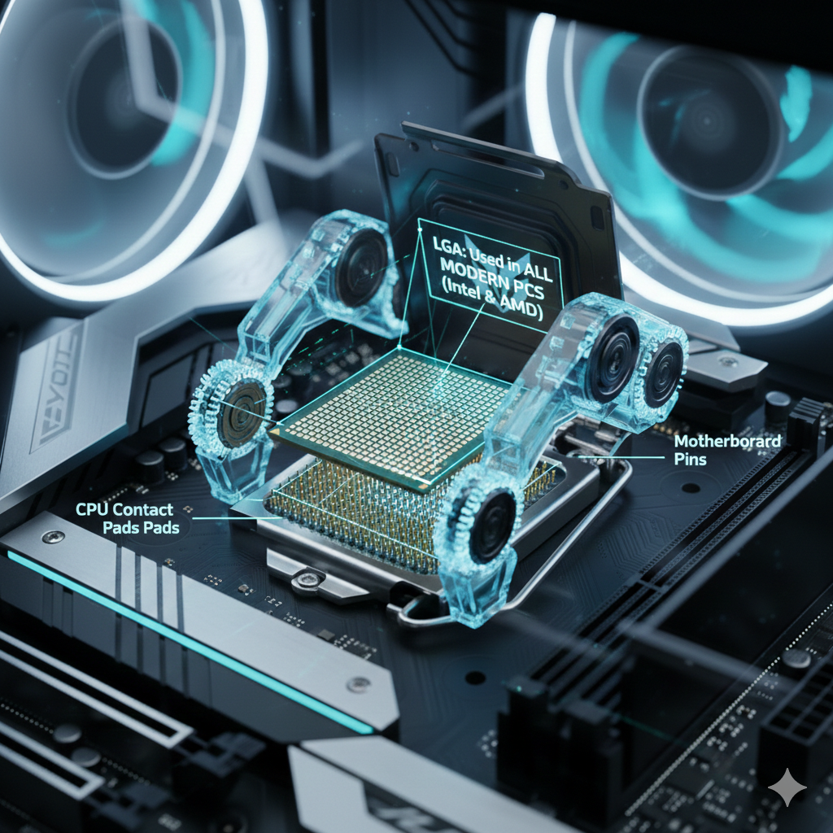
Here is where LGA is used right now:
1. All New Desktop Computers
Intel: Every Intel desktop processor since 2004 uses LGA. This includes the newest Core Ultra (Series 2) chips which use the LGA 1851 socket.
AMD: AMD switched to LGA with their AM5 platform. This means all Ryzen 7000, 8000, and 9000 series chips use LGA.
2. Servers and Data Centers
LGA is the only choice for big servers (like those running Google, AI, or websites).
3. High-End Workstations
Professionals who do video editing or 3D design use LGA.
BUT NOT USE IN LAPTOP AND OLD PC
LGA

Slide 7
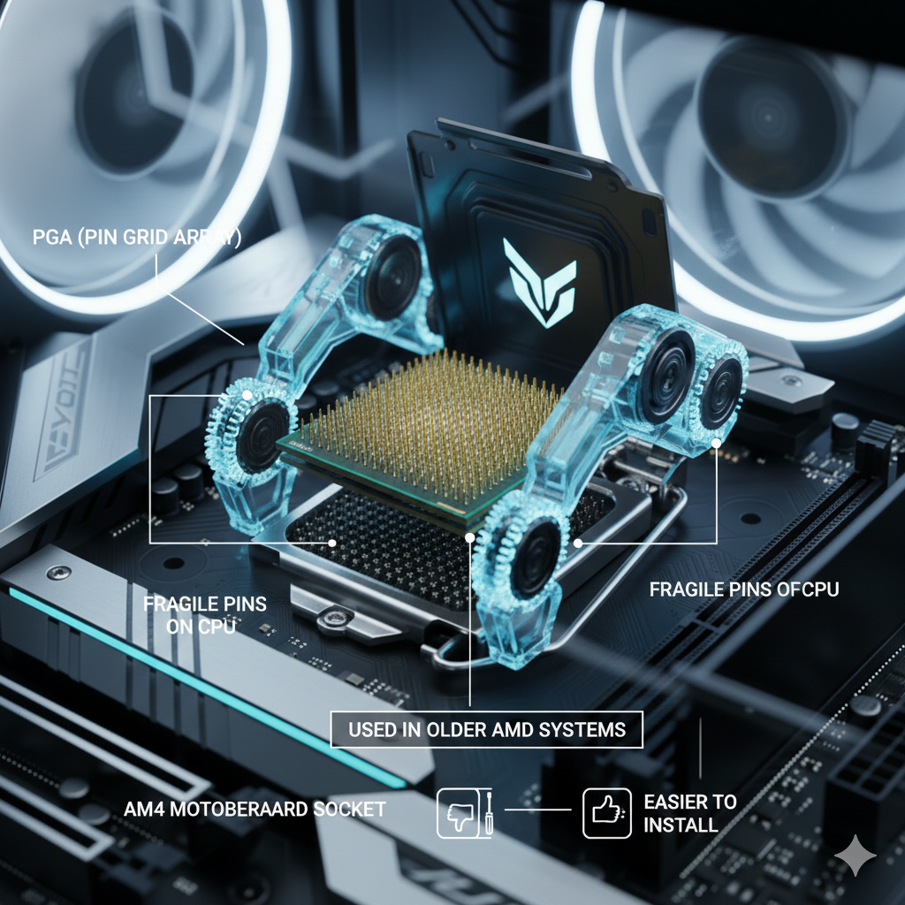
Here is where LGA is used right now
1. Older AMD Computers (AM4)
few years ago (like the popular Ryzen 5000, 3000, or 2000 series), it uses the AM4 socket
2. Laptops (Older or Specialized)
3. Industrial Machines and ATMs

Slide 8
Price Comparison (Estimates for 2026)
Part | LGA (Modern / High Speed) | PGA (Older / Budget)
CPU Price | $200 – $600+ | $80-250
Motherboard | $150 – $400+ | $60 – $150
Total Entry Cost | Higher (Newer parts) | Lower (Older parts)
Repair Cost | $100-$200 (Replace board) | $100-$500 (Replace CPU)

Slide 9
Thank you
0326766767
Ihtesham.khan126@gmail.com

